Slide 1
mSMART
Mayo Stratification for Myeloma And Risk-adapted Therapy
Management of Teclistamab Cytokine Release Syndrome (CRS) and
Immune Cell Associated Neurotoxicity Syndrome (ICANS)
Teclistamab was approved by FDA on October 25, 2022 for relapsed, refractory myeloma
After 4 prior lines of therapy AND
Exposure to proteasome inhibitor, IMiDs, and anti-CD38 antibody
Package insert and REMS (Risk Evaluation and Mitigation System) provides guidelines for step up dosing adjustment for CRS and ICANS
This consensus opinion specifically addresses acute management of CRS and ICANS
v1 //last reviewed Jan 2023.

Slide 2
Options for Management of Teclistamab associated CRS
Consider disease debulking whenever possible to reduce CRS risk during step-up dosing.
For treatment centers with capability for outpatient monitoring and rapid escalation of inpatient care when needed, initial monitoring with Teclistamab doses can be done outpatient.
Proactive intervention should be given early in the onset of CRS to reduce the likelihood of progression to higher grade.
Prophylactic cytokine blockade with bispecific antibody is being studied and not standard of care at this time.
Grading (ASTCT 2019 guideline)¹ | Tocilizumab | Steroid | Other management considerations
Grade 1 (fever only, without hypotension or hypoxia) | Can be given. Can repeat dose q8hr if no improvement for up to 3 doses total. | Can be given. DEX 10 mg PO/IV. If given first, consider tocilizumab if no improvement in 4 hours. | Consider inpatient monitoring for institutions able to monitor outpatient depending on clinical escalation of symptoms and infrastructure support Assess for infections
Grade 2-4 | Same as Grade 1. If no improvement after the first dose of toci, see other management section. Consider additional cytokine blockade such as siltuximab, anakinra. | DEX up to 10-20 mg PO/IV q6hrs If no improvement within 24 hours, methylprednisolone 1000 - 2000 mg IV daily for up to 3 days, and taper q2-3 days as tolerated. | Inpatient monitoring. Cytokine panel monitoring if more than 1 dose of toci needed or scheduled steroid given. Consider alternative cytokine blockade. Monitor cardiac, renal and hepatic functions. If dysfunction not attributed to other causes, manage as refractory CRS.
v1 //last reviewed Jan 2023.
1. Lee DW et al. BBMT 2019; 25: 625-638. PMID:30592986.

Slide 3
Options for Management of Teclistamab associated CRS
Additional medications have been used to manage CAR-T and T cell engagers associated severe CRS, HLH/MAS. Use may be off label usage and not covered by insurance
Medication | Starting Dose | Comment(s)
Anakinra | 100 mg subQ BID | IV doses can be given if concerns for subQ absorption. Dose up to 48 mg/kg/day and 3500 mg/day IV for 3 days have been tolerated in infection and COVID-19. Max dose: 100 mg bolus, 2mg/kg/hr IV.
Siltuximab | 11mg/kg IV over 1-hour x 1 | If cytokine blockade in IL-6 strongly consider.
Basiliximab | 20 mg IV x1 | If cytokine blockade in IL-2 strongly consider Assess response after 6 to 8 hours; for robust responses additional doses can be given 4 days after the first.
Etoposide | 150 mg/m^2 IV twice a week | Not exceeding a cumulative dose of 2 grams.
Ruxolitinib | 5mg po BID with a max of 20 mg po BID
Etanercept | 25 mg subQ 2 times a week
Cyclosporine | trough of 200 to 250
Emapalumab | 1 mg/kg IV 2 times a week | Non-formulary treatment and may increase administration time. If cytokine blockade in IFN-γ strongly consider. Max Dose: 10 mg/kg IV 2 times a week.
v1 //last reviewed Jan 2023.

Slide 4
Management of Teclistamab associated CRS
Tocilizumab
1 dose
OR
Can start with
Dexamethasone 10 mg PO/IV
1 dose
No improvement in 4 hours
No improvement in 8 hours
Tocilizumab
Repeat IV q8h (up to 3 doses total)
Can add Dexamethasone 10-20 mg PO/IV q6h
For progressive symptoms after the second dose of Tocilizumab consider alternative cytokine blockade
Methylprednisolone 1000-2000 mg IV daily x 3 days and taper over 2-3 days as tolerated.
v1 //last reviewed Jan 2023.

Slide 5
Options for Management of Teclistamab associated ICANS
Grading (ASTCT 2019 guideline)¹ | Steroid | Other management considerations
Grade 1 (ICE score 7-9, awakens spontaneously, no seizure, motor deficits, increased ICP or cerebral edema) | Consider DEX 10-20 mg PO/IV daily. | If ICANS occurs during CRS and tocilizumab has not been given for CRS, tocilizumab can be given for CRS. Consider initiating steroid for neurologic presentation that impacts patient safety. Consider monitoring without steroid for dysphasia presentation alone. Consider addition of Keppra for seizure prophylaxis.
Grade 2-4 | DEX 10-20 mg PO/IV up to q6hr. De-escalate as quickly as tolerated when improved to Gr 1 or less. Methylprednisolone, consider 2 mg/kg or up to 1000-2000 mg IV daily dose if symptoms continue to worsen despite DEX. | Neurologic evaluation as appropriate to rule out increased intracranial pressure (ICP), cerebral edema, seizure, and infections.
v1 //last reviewed Jan 2023.
1. Lee DW et al. BBMT 2019; 25: 625-638. PMID:30592986.

Slide 6
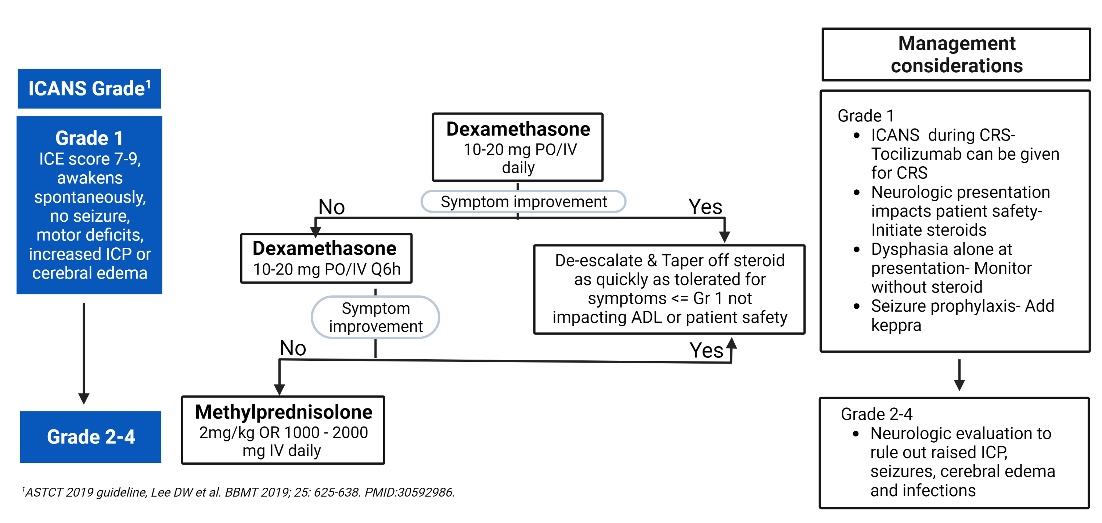
Management of Teclistamab associated ICANS
v1 //last reviewed Jan 2023.

