Slide 1
mSMART
Mayo Stratification for Myeloma And Risk-adapted Therapy
Management of Cytokine Release Syndrome (CRS) and
Immune Cell Associated Neurotoxicity Syndrome (ICANS)
Idecabtagene vicleucel (ABECMA) and Ciltacabtagene autoleucel (CARVYKTI) are approved by FDA for relapsed, refractory myeloma
After 4 prior lines of therapy AND
Exposure to proteasome inhibitor, IMiDs, and anti-CD38 antibody
Package insert and REMS (Risk Evaluation and Mitigation System) provides guidelines for product specific management of CRS and ICANS
This consensus opinion specifically addresses general principles of management of acute and subacute adverse events
Early communication and referral to CAR-T treatment center is recommended to facilitate efficient coordination to get patient to treatment
v1 //last reviewed Mar 2023.

Slide 2
Management of CAR-T associated CRS
Management
Considerations
Tocilizumab
Grade 1
For treatment centers with capability for outpatient monitoring and rapid escalation of inpatient care when needed, initial monitoring can be done outpatient.
Assess for infections
If grade 1, and no improvement
in 4 hours, consider
Dexamethasone 10 mg PO/IV q24h
If grade 1, and no improvement in 8 hours
Or progression to Grade 2 or higher
Can add
Grade 2 - 4
Inpatient monitoring
Monitor cytokine panel and consider alternative cytokine blockade
Monitor cardiac, renal, hepatic functions, coagulopathy. If dysfunction not attributed to other causes, manage as refractory CRS.
Vigilant monitoring for infections
Tocilizumab
Repeat IV q8h
(up to 3 doses total)
For progressive symptoms after the second dose of Tocilizumab consider alternative cytokine blockade. Anakinra has been most commonly-used after tocilizumab.
Dexamethasone 10-20 mg PO/IV q6h
If no improvement, escalate to Medrol below
Methylprednisolone 1000-2000 mg IV daily x 3 days and taper over 2-3 days as tolerated.
Consider disease debulking during CAR-T manufacturing whenever possible to reduce CRS risk.
Proactive intervention should be given early in the onset of CRS to reduce the likelihood of progression to higher grade.
Prophylactic cytokine blockade is being studied and not standard of care at this time.
v1 //last reviewed Mar 2023.
1. Lee DW et al. BBMT 2019; 25: 625-638. PMID:30592986.

Slide 3
Options for Management of severe CRS & IEC-HS*
Additional medications have been used to manage CAR-T associated severe CRS, IEC-HS (Immune effector cell associated hyperinflammatory syndrome). Use may be off label usage and not covered by insurance.
Medication | Starting Dose | Comment(s)
Anakinra | 100 mg subQ BID | IV doses can be given if concerns for subQ absorption. Dose up to 48 mg/kg/day and 3500 mg/day IV for 3 days have been tolerated in infection and COVID-19. Max dose: 100 mg bolus, 2mg/kg/hr IV.
Siltuximab | 11mg/kg IV over 1-hour x 1 | If cytokine blockade in IL-6 strongly consider.
Basiliximab | 20 mg IV x1 | If cytokine blockade in IL-2 strongly consider Assess response after 6 to 8 hours; for robust responses additional doses can be given 4 days after the first.
Etoposide | 150 mg/m^2 IV twice a week | Not exceeding a cumulative dose of 2 grams.
Ruxolitinib | 5mg po BID with a max of 20 mg po BID
Etanercept | 25 mg subQ 2 times a week
Cyclosporine | trough of 200 to 250
Emapalumab | 1 mg/kg IV 2 times a week | Non-formulary treatment and may increase administration time. If cytokine blockade in IFN-γ strongly consider. Max Dose: 10 mg/kg IV 2 times a week.
Cyclophosphamide** | 1 g/m^2 IV
ATG (rabbit)** | 2 mg/kg/day IV
** For refractory, potentially fatal severe CRS or IEC-HS where high expansion of CAR-T is detected, lymphotoxic agents such as high dose cyclophosphamide or ATG may be considered.
v1 //last reviewed Mar 2023.
*Hines M; Knight T; McNerney K, et al TCT 2023.

Slide 4
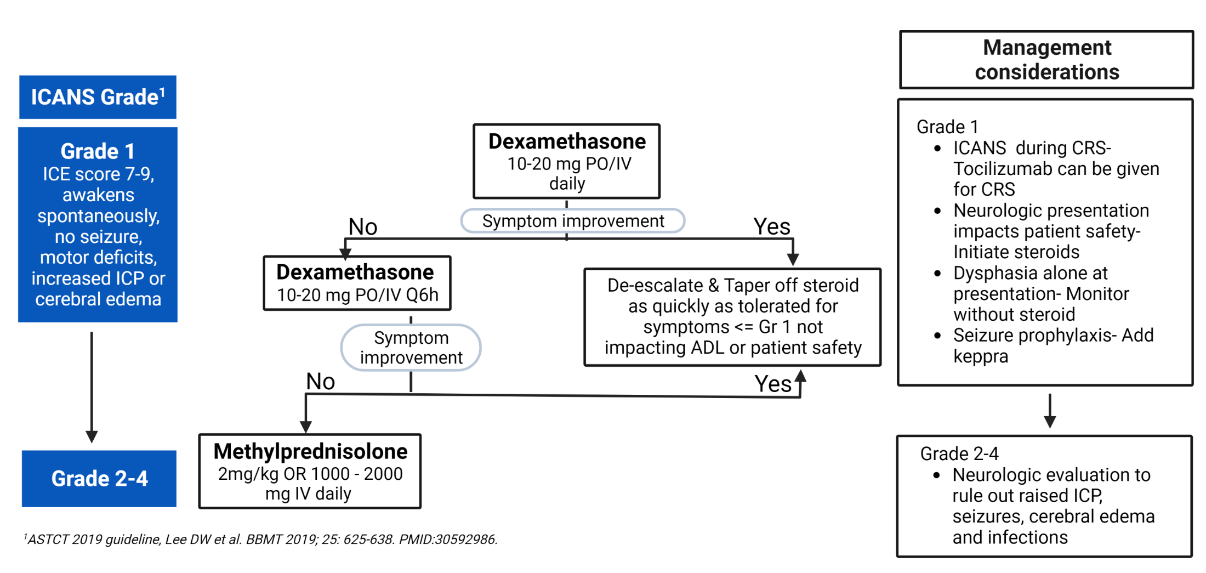
Management of ICANS associated with CAR-T
Cerebral edema should be co-managed with Neurology ICU specialists. Consider adding mannitol and lymphotoxic agents.
v1 //last reviewed Mar 2023.

Slide 5
Management of Late Onset Neurotoxicity
Typical onset 1-3 months post CAR-T infusion.
Clinical course can be prolonged. Spontaneous improvement can be seen, but can take months to > 1 year.
Understanding of optimal management continue to evolve. Management in discussion with CAR-T treatment center is recommended.
Cranial nerve palsies
Parkinsonism
Typically bilateral in presentation
MRI finding of cranial nerve inflammation can be seen
Steroid for severe manifestation
Mitigation strategy with disease debulking prior to CAR-T and early intervention for CRS has reduced incidence in clinical trials
Supportive care
Sinemet and aggressive treatment such as systemic and or intrathecal lymphotoxic drugs have not been associated with improvement, and should be considered weighing severity of symptoms and side-effects of treatments

Slide 6
Management of Post CAR-T Cytopenia
Evaluations
Management
Month 1
Grade 3 or higher cytopenia can be common depending on cytopenia prior to CAR-T and CRS severity
Rule out persistent or recurrent inflammation:
CRP, ferritin, bone marrow biopsy
Rule out nutritional deficiencies:
Iron studies, pernicious anemia eval, copper, zinc
Rule out infection:
PCR for CMV, EBV, parvovirus B19, HHV6
If IEC-HS identified, consider anakinra, add steroid if refractory. Escalate immunosuppressive agents if refractory.
If nutritional deficiencies or infections identified, treat as appropriate
Continue blood count monitoring and transfusion support
Variable success with growth factor and thrombopoietin mimetics
Month 3
Anticipate cytopenia improvement to grade 2 or less
Rule out nutritional deficiencies and infections as above if not tested earlier
Rule out persistent or recurrent inflammation:
CRP, ferritin
Rule out MDS, T-MN
Bone marrow biopsy with cytogenetic testing
If MDS and T-MN is ruled out, consider stem cell boost in patients with grade 3 or higher cytopenia and who have stem cells available
Antibacterial prophylaxis should be given during prolonged neutropenia
Antifungal prophylaxis should be given in month 1 post CAR-T and continued if patient is receiving chronic immunosuppressive medications
Antiviral prophylaxis and PJP prophylaxis should be continued until CD4 T cells count is persistent >200. (This can take 1 year or longer.)
Prophylactic IVIG, 400 mg/kg IV, should be given monthly for IgG<400 mg/dL, or for patients with IgG<600 mg/dL and have frequent infections.
v1 //last reviewed Mar 2023.

